Slide 1

5 minutes quiz
If A = $\left(\begin{matrix}5 & −2 \\ 3 & −1\end{matrix}\right)$ and B = $\left(\begin{matrix}−1 & 2 \\ −3 & 5\end{matrix}\right)$, determine:
A + B
2A
A – B
AB
(A – B)²
A² – B²

Slide 2
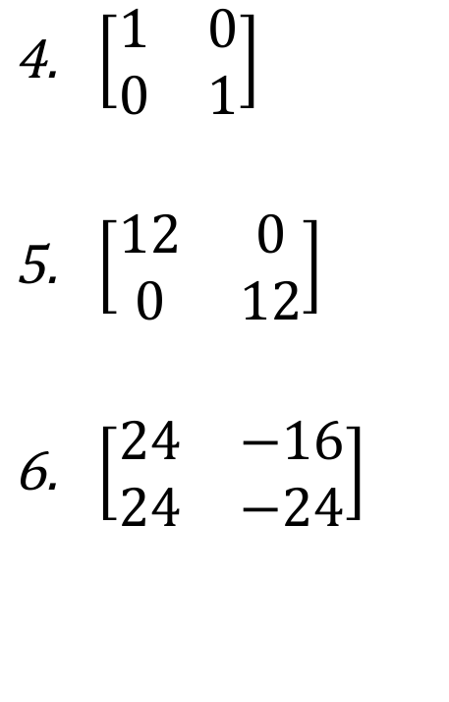
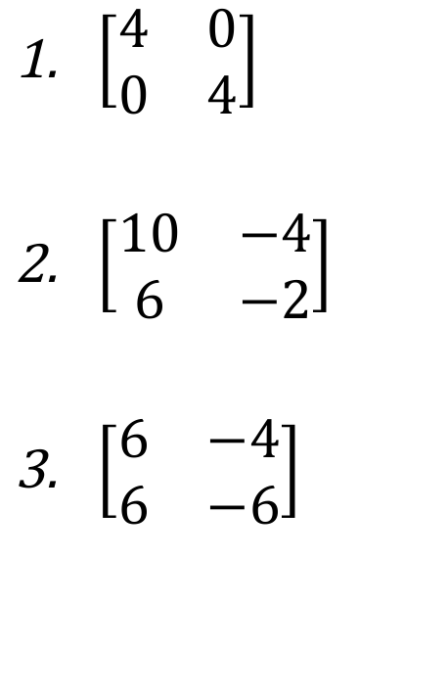
Answers
$\left[\begin{matrix}4 & 0 \\ 0 & 4\end{matrix}\right]$
$\left[\begin{matrix}10 & −4 \\ 6 & −2\end{matrix}\right]$
$\left[\begin{matrix}6 & −4 \\ 6 & −6\end{matrix}\right]$
$\left[\begin{matrix}1 & 0 \\ 0 & 1\end{matrix}\right]$
$\left[\begin{matrix}12 & 0 \\ 0 & 12\end{matrix}\right]$
$\left[\begin{matrix}24 & −16 \\ 24 & −24\end{matrix}\right]$

Slide 3
Pythagoras’ Theorem

Slide 4
Pythagoras’ Theorem
c
(hypotenuse)
a
b
a² + b² = c²

Slide 5
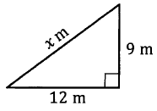
Example

Slide 6
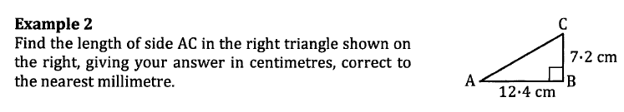

Slide 7
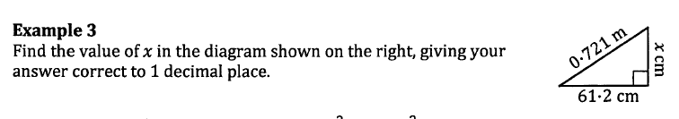

Slide 8
